Slide 1
Data Management in Supply Chain Using Blockchain
Supervised By: Submitted By:
Dr. Amit Banerjee M.Mohaiminul Islam
Assistant Professor ID: SAU/CS(M)/2019/07

Slide 2
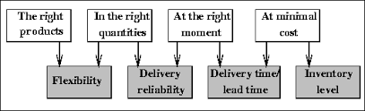
What is Supply chain management?
Supply chain management (SCM) is fundamental for gaining financial, environmental and social benefits in the supply chain industry.
SCM is the management of flow of goods and service and includes all process that transform raw materials into final products. By managing the supply chain, companies are able to cut excess costs and deliver the product to the customer faster.

Slide 3
Issue with Traditional SCM
Although the supply chain industry has great potential for development, traditional SCM mechanisms usually suffer from a wide scope of issues such as lack of information sharing, long delays for data retrieval, and unreliability in product tracing.
Some stakeholders store the data in a stand-alone and off-line way. Moreover, the information is exchanged via the postal system. However, stand-alone and centralized data management brings some problems. First, data can be tampered which could intrude the data authenticity. Besides, system security can be violated . Finally, the retrieval of the data is time-consuming.
Facing the aforementioned issues, people are heading towards the application of the blockchain technology on SCM.

Slide 4
What is blockchain?
Blockchain is related to bitcoin , the cryptocurrency . initially it was made for the financial transaction but it is now revolutionizing the business world especially supply chain. Its just like google sheet with regular transaction there is a middleman like the bank that register the transaction, a centralized system but bitcoin transaction are between user to user so when there’s a transaction that information is recorded on a shared ledger(block) and these blocks are linked together to form a blockchain like shared google doc. Transaction accuracy is driven by the fact the consensus creates truth. In blockchain database every participant or node maintains a copy of the shared ledger. Each transaction on the blockchain is recored in computer code showing who the parties are, transaction details and timestamp with each containing a unique math based encrypted signature. This digital signature is key as it follows each block of information to be securely connected to all the rest. If there were an unauthorized change, each node is notified and can see where it took place and then recognize weather it is valid or not valid. This way, transparency and consensus make the blockchain system virtually tamperproof.

Slide 5
Consensus in Blockchain
We know that Blockchain is a distributed decentralized network that provides immutability, privacy, security, and transparency. There is no central authority present to validate and verify the transactions, yet every transaction in the Blockchain is considered to be completely secured and verified. This is possible only because of the presence of the consensus protocol which is a core part of any Blockchain network.
A consensus algorithm is a procedure through which all the peers of the Blockchain network reach a common agreement about the present state of the distributed ledger. In this way, consensus algorithms achieve reliability in the Blockchain network and establish trust between unknown peers in a distributed computing environment. Essentially, the consensus protocol makes sure that every new block that is added to the Blockchain is the one and only version of the truth that is agreed upon by all the nodes in the Blockchain.

Slide 6
Types of Consensus Algorithm
Proof of Work(POW): This consensus algorithm is used to select a miner for the next block generation. Bitcoin uses this PoW consensus algorithm. The central idea behind this algorithm is to solve a complex mathematical puzzle and easily give out a solution. This mathematical puzzle requires a lot of computational power and thus, the node who solves the puzzle as soon as possible gets to mine the next block.
It’s an issue that requires a lot of computational power to solve 51 percent attack.

Slide 7
Cont.
Proof of Stake(POS): This is the most common alternative to PoW. Ethereum has shifted from PoW to PoS consensus. In this type of consensus algorithm, instead of investing in expensive hardware to solve a complex puzzle, validators invest in the coins of the system by locking up some of their coins as stake. After that, all the validators will start validating the blocks. Validators will validate blocks by placing a bet on it if they discover a block which they think can be added to the chain. Based on the actual blocks added in the Blockchain, all the validators get a reward proportionate to their bets and their stake increase accordingly.

Slide 8
Cont.
Practical Byzantine Fault Tolerance (PBFT):
pBFT focuses on providing a practical Byzantine state machine replication that tolerates Byzantine faults (i.e. malicious nodes) by assuming there are independent node failures and manipulated messages sent through specific nodes.
Nodes in a pBFT system are sequentially ordered with one node being the leader and others referred to as backup nodes. All nodes in the system communicate with one another with the goal being that all honest nodes will come to an agreement of the state of the system using a majority rule.
Communication between nodes has two functions: nodes must prove that messages came from a specific peer node, and they must verify that the message was not modified during transmission.
For the pBFT system to function, the number of malicious nodes must not equal or exceed one third of all nodes in the system in a given vulnerability window. Similar to the proof of work consensus mechanism, the more nodes there are in a pBFT network, the more secure it becomes.

Slide 9
Blockchain for SCM
The magic of blockchain lies in the protocol of validating new blocks, in short, consensus mechanism. The majority of the nodes will agree on the presence of each block via consensus algorithm after validating the data in the block. It can be quite difficult to tamper the data on the blockchain since most of the nodes will not admit it.
by using the blockchain to store and manage the data flow in the supply chain, the information cannot be easily tampered and treated as reliable proof of existence.
data from different stakeholders in the supply chain can be integrated into the blockchain system rather than separately stored in individual systems, which not only helps for the data sharing but save cost and time for data retrieval.

Slide 10
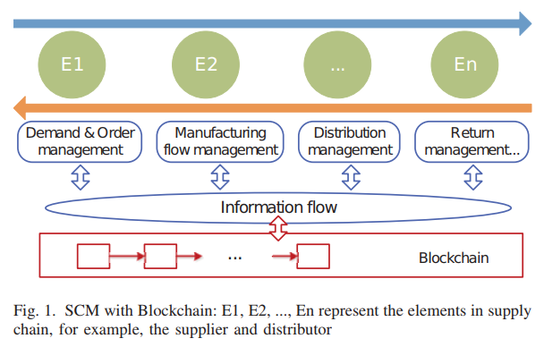
EXISTING WORKS & ISSUE ON SCM WITH BLOCKCHAIN
There are some existing works performing conceptual studies on how to improve SCM by applying the blockchain technology. The adoption of blockchain for SCM is commonly related to supply chain data management As shown in Fig, the blockchain systems is connected to the information flow. The data for SCM is the input to the blockchain system. For data management, especially for the supply chain.

Slide 11
Issue With Existing SCM Based Blockchain
The first issue is to collect the data where the sensing technologies can play their roles and to collect the data from the physical world and convert it into digital information.
Some barriers are still present if the blockchain is put into practical use for SCM in terms of the immaturity of the current blockchain technology and the cost of its deployment.
Now,analyze fours challenges of blockchain technology that affect, explicitly or implicitly, the supply chain
A)> i) Scalability: A large number of stakeholders are participating in modern supply chains. Blockchain can contribute significantly by providing a networked and decentralized database in order for all supply chain parties to join but How the system can scale and operate with the increasing number of stakeholders and a large amount of generated transactional data is the prime challenge.

Slide 12
Cont.
ii)Network Scalability: The essence of blockchain technology innovation and uniqueness originates from the use of consensus mechanisms. Apparently, there is no common tool on modern supply chains that organizes and secures each step of the product. Hence errors, fraud, and ware failure are possible.
iii) Storage Scalability: As the number of transactions increasing day by day, the blockchain becomes heavy since all transactions have to be stored for validating the transaction.So, the increased block size slows the propagation speed down, which leads to blockchain forks. So scalability is quite a tough problem in the blockchain.
B)Throughput: With its current block size of 1 MB and 10 minute inter-block interval, the maximum throughput is capped at about seven transactions per second [27]; and a client that creates a transaction has to wait for at least 10 minutes on average to be sure that the transaction is included in the blockchain .

Slide 13
Cont.
C) Access Control: The modern supply chains suffer from participants’ societal fears about loss of privacy and data protection where any kind of data is available and can possibly be tampered. This makes many large companies unwilling to share their data which creates data silos along the supply chain.
D)Data Retrieval: Participants have different requirements and expectation for data retrieval. Wholesalers want to trace forward the product to get the accurate situation of sales in order to make a better marketing strategy and increase the revenue in return. The consumers want to know the authenticity of the product quickly so that they can confidently decide the purchase without too much hesitation. Those requirements place challenges in data retrieval.

Slide 14
Proposed a system framework for the Food based SCM in blockchain
Introduce a system framework to build a blockchain-based SCM system. Then, demonstrate the implementation based on Hyperledger Fabric with the functionality design, system architecture, and implementation details. Finally, conduct extensive experiments to analyze the system performance in terms of response times of user registration, data submission, and data query.
A. System Overview: Food safety is the major concern for the society nowadays. Problems including food fraud, illegal production and foodborne illness in the food supply chain have resulted in much damage to customers’ health and loss in the food industry.
system adopts the concept of Blockchain as a Service (BaaS). BaaS is an offering that allows customers to leverage cloud-based solutions to build, host and use their own blockchain apps and functions

Slide 15
Cont.
This newly proposed blockchain-based food traceability system is built upon the Hyperledger Fabric, which is an open-source and permissioned distributed ledger technology platform. The reason why we use the Fabric is that it provides modular and configurable architecture, which is potential for the realization of BaaS. Besides, it is permissioned which is similar to the federated blockchain.
In this system PBFT consensus mechanism is used for leader election in the system. Then, the selected node would select and pack data pieces into one block.
The general framework of our food traceability system is shown in Fig.

Slide 16
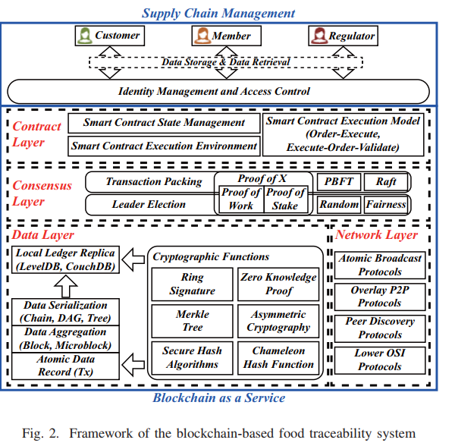
System Overview:

Slide 17
Cont.
In this system, there are three kinds of identities, which are the regulator, member, and customer.
i)Regulator: Regulators have the highest level of access to the blockchain, all the information can be visible to regulators for censorship. In practice, the regulator can be food safety association or other official organizations.
ii)Member: Members refer to the suppliers, companies and other parties in the food supply chain. They have rights to write & submitting information to the blockchain. they can only search the last source and next step of the food transferred in the supply chain.
iii)Customer: Customers do not need to write in, and the information exposed to them. only tells the information about the main producer of the food product and the origin areas of the raw food. The intermedia information will be hidden for the customers
These avobe 3 identities use their own private key for log in.the identity check in is implemented by the smart contract.

Slide 18
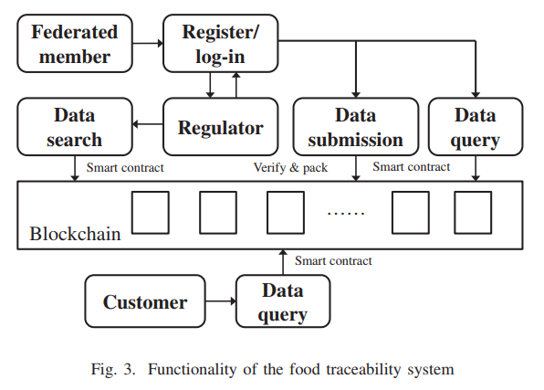
Cont.
The functionality of the system is briefed in Fig. 3. Regulators and federated members are required to log into the system before further operation. New federated members should register for legitimate access to the system, which would be given by the regulators. The registration records and access records would all be stored on the blockchain as proof.
Federated members can submit food information and query previously submitted data by invoking smart contract. The submitted food information will be verified by the peers and published on the blockchain.

Slide 19
Cont.
Regulators, they are search any information existed in the ledger. While for customers, they only can query the information about the food they bought from retailers. There are different smart contracts from implementing the query and search request sent by the regulators, members and customers.
For setting the nodes for the food blockchain, there should be full nodes and light nodes in the network. The full nodes can be set by the regulators, while the light nodes are created by the members.
The reason for doing this is that only the regulators could see all the information across the food supply chain due to the privacy concerns of business competitors. Another reason is that, if only regulators have the full nodes, the information can be trustless for the members if regulators tamper the original data. Therefore, a group of members could have light nodes that store their own food information.

Slide 20
B)System Implementation
For the System and Data Setup, deploy 4 nodes within department intranet to evaluate the system. The node is capable of running 4 docker containers for different roles, i.e., 2 for client peer, 1 for orderer and 1 for endorser. Each node has individual IP such that they can communicate with each other.
Client: a client that submits an actual transaction invocation to the endorsers, and broadcasts transaction proposals to the ordering service. • Orderers: a node that commits transactions and maintains the state and a copy of the ledger. • Endorser: a node running the communication service that implements a delivery guarantee, such as atomic or total order broadcast.

Slide 21
System Analysis
Invoke the chaincode (smart contract) with 10, 30, and 50 concurrent jobs at the same time and repeat the experiment 10 times to get the average time for the registration which is successfully finished and recorded on the blockchain, as depicted in Fig. 4 as cumulative distribution function (CDF) plot. We also apply the same testing parameters to the function of Transaction Uploading and Data Retrieving as depicted in Fig. 5 and Fig. 6 as CDF plots respectively.
With the CDF plots from the experimental data, it is no hard to find that with the increased number of concurrent jobs within one chaincode, the system response time will increase linearly. Still, the time of data retrieving will increase significantly with the increase of concurrent jobs. When we send 10 queries to the blockchain, we can get the most results within 0.3 second. However, the average response time of 50 queries takes close to 1 second.

Slide 22
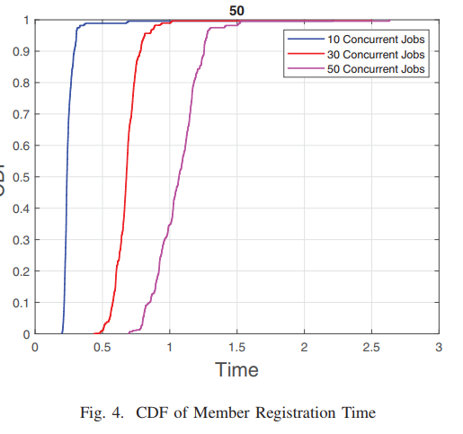
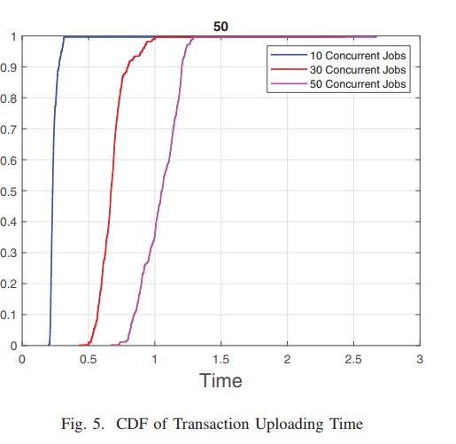
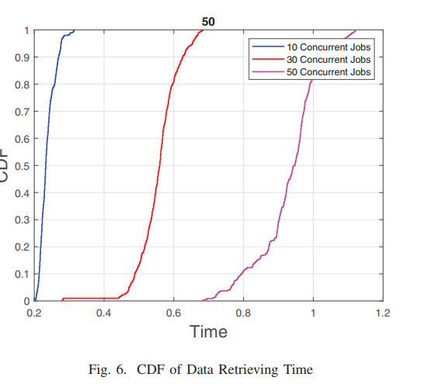
Cont.

Slide 23
Cont.
Privacy Analysis: All the data, e.g. transactions, logs, system events, on the blockchain are encrypted with private-public key pairs. Only the user with the corresponding private key, in the form of owning or being given access rights, can decrypt and view the data. The transaction data can only be seen from neighbor hops, by system default configuration, when doing the data retrieval.
This guarantees the traceability of the system while safeguarding the privacy of data. Only the administrator, e.g. the government, FDA, can trace the entire history when consumer sends an appealing request about the disputed product.

Slide 24
Problem Definition
From the above graph and discussion can conclude that ,though in this system framework we overcome the privacy issue but we don’t get good throughput using this framework. when the number of transaction is increasing ,it takes lot of time and data retrieval is also time consuming.
The current system TPS is not high due to the following factors: 1) The current Hyperledger Fabric framework is a generic framework supporting different applications, and it is not optimized for high TPS.
One of the reason for not getting the good result is that the system needs to process and verify transactions one by one instead of parallel.
The transaction size is big and not optimized yet.

Slide 25
Possible Solution
The possible solutions can be:
i) bundling multiple item submission in the transaction. ii) increase the number of transactions per block.
We can also achieve higher utility rate (payload/total block size) to increase the efficiency by packing related food items together, in a single transaction atomically.
Moreover, more complex packing algorithm, with the higher computational requirement is needed to lower the real-time capacity. Overall, further study is needed to propose a framework on adjusting the block size and number of transactions to balance system throughput and real-time capability.

Slide 26
References:
H. Wu et al., "Data Management in Supply Chain Using Blockchain: Challenges and a Case Study," 2019 28th International Conference on Computer Communication and Networks (ICCCN), Valencia, Spain, 2019, pp. 1-8, doi: 10.1109/ICCCN.2019.8846964.
S. Bhalerao, S. Agarwal, S. Borkar, S. Anekar, N. Kulkarni and S. Bhagwat, "Supply Chain Management using Blockchain," 2019 International Conference on Intelligent Sustainable Systems (ICISS), Palladam, Tamilnadu, India, 2019, pp. 456-459, doi: 10.1109/ISS1.2019.8908031.
S. Yousuf and D. Svetinovic, "Blockchain Technology in Supply Chain Management: Preliminary Study," 2019 Sixth International Conference on Internet of Things: Systems, Management and Security (IOTSMS), Granada, Spain, 2019, pp. 537-538, doi: 10.1109/IOTSMS48152.2019.8939222.
Blockchain Technology for Sustainable Supply Chain ... - MDPI

